Slide 1
Threshold Externalities in Economic Development
Costas Azariadis and Allan Drazen,
The Quarterly Journal of Economics, Vol. 105, No. 2
(May, 1990), pp. 501-526
Notes:
Standard one-sector growth models often have the counterfactual implication that economies with access to similar technologies will converge to a common balanced growth path. They propose an elaboration of the Diamond model that permits multiple, locally stable stationary states. This multiplicity is due to increasing social returns to scale in the accumulation of human capital.

Slide 2
Introduction
High growth rate vs middle growth rates vs low growth “traps”
Tables 1 and 2: persistent differences in national economic performance
Neoclassical models of economic growth like Solow's [1956] or Diamond's [1965] do not suggest such a pattern.
Reasons: Culture, religion, national economic policies, or broadly defined social institutions, that is, to economically "exogenous" factors ?
This paper explores the alternative possibility that sustainable differences in per capita growth rates could appear even among economies with identical structures.
Notes:
International evidence on growth rates in per capita income reveals striking and persistent differences in development patterns among nations. Some countries manage to sustain high growth rates over long periods of time; others advance at acceptable if not spectacular rates; while still others seem to stagnate in low growth "traps," exhibiting persistently low rates of growth or relatively low levels of economic development, or both. Tables I and II illustrate the relative economic performance in the last two centuries of several developed and less developed countries.
These persistent differences are not explained by faster growth in early stages of development, that is, by poorer countries growing faster as they catch up with richer ones. From Table I we see, for instance, that Norway experienced accelerating growth for a whole century (1867 to 1965), while Egypt and India grew more slowly than the richer countries of Western Europe and North America. Table II shows that each of the three countries in the sample which grew fastest between 1940 and 1970 (Japan, Greece, and Finland) started out with higher per capita income than any of the three slowest growing countries (Egypt, Thailand, and India). Over the last two decades upper middle income countries as a group appear to develop a good deal more rapidly than the very poorest countries. In fact, six of the world's slowest growing nations' (that is, those with per capita GNP growth rates below minus 1.5 percent per annum in 1965-1985) were already among the very poorest in 1965

Slide 3
II. THRESHOLD EXTERNALITIES AND MULTIPLE EQUILIBRIA
Once state variables such as physical capital or the stock of "knowledge" surpass certain critical values, aggregate production possibilities may expand especially rapidly.
Romer [1986] : disticntion between private and social factors of production
They begin with the well-known one-sector overlapping-generations model of capital accumulation due to Diamond [1965].
Notes:
Section II introduces neutral technological externalities in the standard over- lapping generations model of growth and shows that, in the absence of some mechanism leading to a "threshold effect," the resulting increasing returns are not by themselves sufficient for multiple, locally stable stationary states.
The empirical finding that countries with access to similar technologies and (one supposes) not wildly dissimilar rates of time preference can have persistent differences in growth rates suggests r the stock of "knowledge" surpass certain critical values, aggre- gate production possibilities may expand especially rapidly. In other words, as product per capita rises beyond some critical value, the state variables become more favorable to economic expansion and are, in turn, stimulated by that expansion.
Key to this argument is the distinction, made recently by Romer [1986], between private and social factors of production, that is, between those inputs controlled by individual producers and those not controlled by any single producer alone. As a first illustration of this distinction (and also to fix notation for later use) we begin with the well-known one-sector overlapping-generations model of capital accumulation due to Diamond [1965].

Slide 4

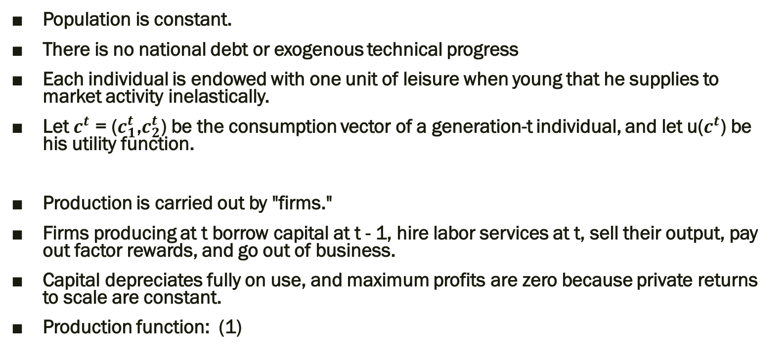
Model setup
Population is constant.
There is no national debt or exogenous technical progress
Each individual is endowed with one unit of leisure when young that he supplies to market activity inelastically.
Let $c^{t}$ = ($c_{1}^{t}$,$c_{2}^{t}$) be the consumption vector of a generation-t individual, and let u($c^{t}$) be his utility function.
Production is carried out by "firms."
Firms producing at t borrow capital at t - 1, hire labor services at t, sell their output, pay out factor rewards, and go out of business.
Capital depreciates fully on use, and maximum profits are zero because private returns to scale are constant.
Production function: (1)
Notes:
(Kt,Lt) are private capital and labor inputs, Yt is output, and F is a linear homogeneous function with the normal monotonicity and concavity properties. The scale factor At may depend functionally on a vector of social inputs that are not controlled by any one producer.
In all cases, social returns to scale are increasing whenever A is a weakly increasing function: a general doubling of all inputs in all periods will boost aggregate output by a factor greater than or equal to two in each period. In the interest of concreteness, we suppose first that At depends on the economywide capital stock.

Slide 5
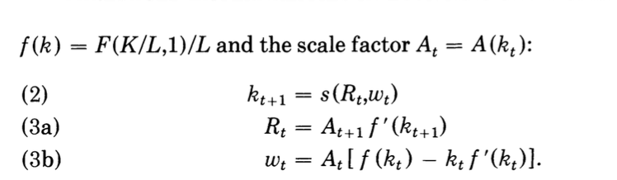
Model setup- cont.
Dynamic equilibria
Equilibrium paths in the closed economy:
Consider the case where social inputs are nonexistent, so that external effects on production vanish, and we may write A(k) = a for all k.
Notes:
Dynamic equilibria in this economy satisfy three familiar relations expressed in terms of the intensive production function. The first of these equates investment per head at t (and, hence, capital per head at t + 1) with saving by workers who earn wage income wt and face a gross yield Rt on loans. Technically, the function s(R,w) is the maximizer of u(w - s,Rs) in the interval [O,w]. Equations (3a) and (3b) are standard factor demand sched- ules by firms. We assume that labor is fully employed and normalize aggregate labor supply to unity.
The function w(k) in this equation simply equals f (k) - kf '(k). Steady states are constant (rather than geometric) sequences of capital per head and output per head; the fixity of labor supply per person simply rules out balanced growth.
Equation (4) then reduces to the standard Diamond model of capital accumulation with zero internal national debt. The set of solutions to the difference equation (4) for A = a is well-known (see Azariadis [1986, Ch. 2]); for each fixed a > 0 it is easy to derive sufficient conditions for the existence of at least one locally stable stationary equilibrium with positive capital intensity.

Slide 6

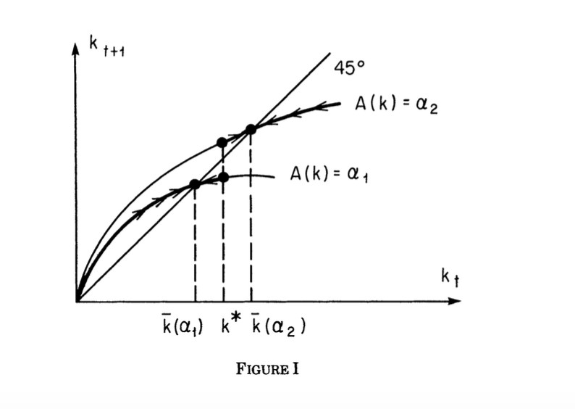

The Model
How technological externalities transform the set of equilibria?
Bifurcations: An economy may generate multiple stable stationary states if it is described by sharply different dynamics for different parameter values.
Threshold effects: radical differences in dynamic behavior arising from local variations in social returns to scale.
Notes:
It is also well-known that the basic Diamond model may easily exhibit multiple steady states.3 However, our interest is to discover how differences in growth patterns relate to the phenomenon of social inputs, not whether they can arise from particular (and perhaps "pathological") specifications of the underlying tastes and technology. Therefore, we restrict consideration to economies in which equation (4) has a unique, nontrivial locally stable steady state k = k(a) > 0 for each fixed a > 0. Figure I graphs equation (4) for two distinct values of a; the upper frontier corresponds to the higher value of a.
Using that figure as a background, we introduce variable scale factors At and ask how technological externalities transform the set of equilibria in this extremely simple neoclassical model of accumulation.
An economy may generate multiple stable stationary states if it is described by sharply different dynamics for different parameter values; technically speaking this economy exhibits bifurcations at critical points. We call threshold effects radical differences in dynamic behavior arising from local variations in social returns to scale.
We shall argue below that such bifurcations may result from the technical features of the accumulation process in an economy with both physical and human capital.
Figure I shows how two nontrivial locally stable steady states will arise in this case if the threshold k * satisfies
lies between the steady states that correspond to the scale factors a, and a2. Economies that start out with capital below the critical value k* will converge monotonically to a steady state in which capital, consumption, and income per head remain relatively low forever. In the absence of outside incentives or direct govern- ment intervention, the initial stock of capital is the only factor affecting which steady state will be reached. The economy "takes off" toward k(a2) if the initial capital per head is above k *.

Slide 7

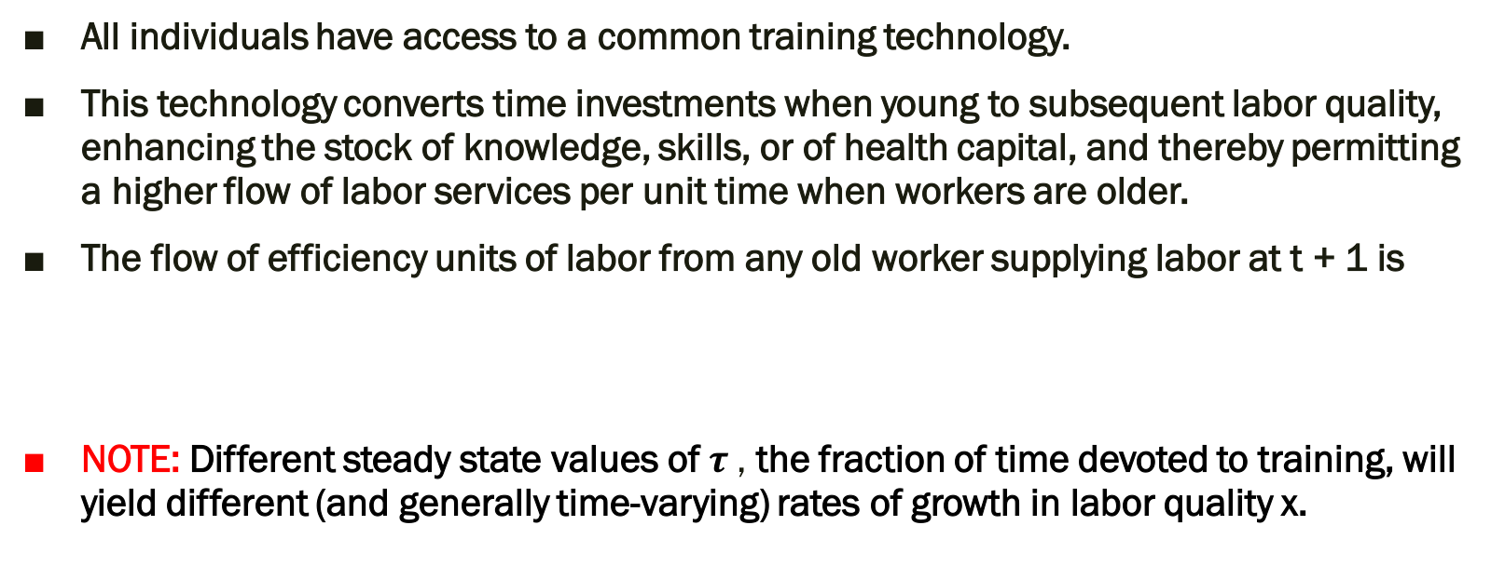
III. BALANCED GROWTH WITH HUMAN CAPITAL
All individuals have access to a common training technology.
This technology converts time investments when young to subsequent labor quality, enhancing the stock of knowledge, skills, or of health capital, and thereby permitting a higher flow of labor services per unit time when workers are older.
The flow of efficiency units of labor from any old worker supplying labor at t + 1 is
NOTE: Different steady state values of $τ$, the fraction of time devoted to training, will yield different (and generally time-varying) rates of growth in labor quality x.
Notes:
The example of the previous section raises the question of whether multiple steady states due to threshold effects are a mere theoretical curiosity, or whether they are instead a pervasive feature of dynamic economies with realistic technological and demographic characteristics. We shall argue that threshold externalities may easily arise in the accumulation of human capital. We shall first set out a general model and then consider various specialized versions of it that help us isolate the origins of threshold effects.
We begin by assuming that all individuals have access to a common training technology. This technology converts time investments when young to subsequent labor quality, enhancing the stock of knowledge, skills, or of health capital, and thereby permitting a higher flow of labor services per unit time when workers are older. In particular, the flow of efficiency units of labor from any old
where T+ e (0,1) is the fraction of time invested at t in labor quality, i.e., in formal education, training, or health maintenance. We may assume h to be a weakly increasing and concave function of r such that h(O,x) - 0 for all x > 0; and xt is the quality of labor services inherited by all generation-t households.
A noteworthy feature of this specification is that different steady state values of r, the fraction of time devoted to training, will yield different (and generally time-varying) rates of growth in labor quality x. This appears to be a natural assumption as long as educational attainment does not fully depreciate from one period to the next. Next period's stock of knowledge, xi+1, attained by individual i, should depend positively on currently available knowledge, and the change in x will depend on r. The expression on the right-hand side of equation (6) need not be multiplicative; what matters is simply that the elasticity of xt+1 with respect to xt be greater than one. Note that the variable xt on the right-hand side of (6) represents both the average quality of labor of both young and old at t, and the number of efficiency units of labor services per unit time with which the young are endowed. We continue with the assumptions of homogeneous households and zero population growth (both of which are dispensed with at little cost in notation); all young households at t start out with an initial endowment of time (equal to 1) and of quality of labor services (equal to xt).

Slide 8
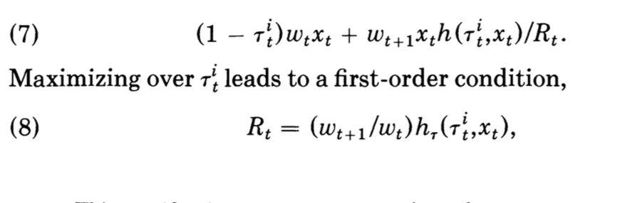

Model setup
The individual's labor supply decision is no longer trivial as in the previous section, for he must decide what fraction of his time to invest in training when young.
Assuming that training provides zero nonpecuniary benefits, $τ$ is simply chosen to maximize discounted lifetime income (7)
Notes:
The individual's labor supply decision is no longer trivial as in the previous section, for he must decide what fraction of his time to invest in training when young.
FOC: which equates the yields on human and physical capital at any interior maximum.

Slide 9
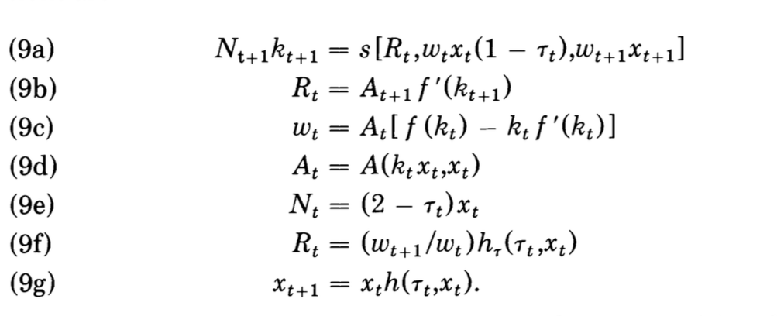
General model: cont.
kt- capital per unit of efficiency labor services
Wt -the wage rate per efficiency unit
(9a) balances investment with saving
(9b) and (9c) are factor demands
(9d) allows both physical and human capital to be social inputs
(9f) and (9g) describes the role of human capital in the growth process
Notes:
Equations (9a)-(9d), in particular, correspond exactly to (2) and (3) with kt denoting capital per unit of efficiency labor services and wt describing the wage rate per efficiency unit. Specifically, (9a) balances investment with saving: the function s(R,yly2) now de- scribes saving by a representative household with income profile (y1,y2).6 Equations (9b) and (9c) are factor demands, while (9d) allows both physical and human capital to be social inputs.
The role of human capital in the growth process is described by equations (9f) and (9g); (9f) is the first-order condition for individ- ual choice of labor quality by homogeneous individuals, while (9g) gives the evolution of average skills implied by individual decisions. A steady state of the economy that evolves according to (9a)-(9g) is a competitive equilibrium in which intensive variables such as -rand
hare constant over time while extensive ones like cl, c2, xt, Kt, Nt, and Yt may either be constant or grow geometrically.
(9a) balances investment with saving: the function s(R,yly2) now de- scribes saving by a representative household with income profile (y1,y2).6
The role of human capital in the growth process is described by equations (9f) and (9g); (9f) is the first-order condition for individ- ual choice of labor quality by homogeneous individuals, while (9g) gives the evolution of average skills implied by individual decisions. A steady state of the economy that evolves according to (9a)-(9g) is a competitive equilibrium in which intensive variables such as -rand
hare constant over time while extensive ones like cl, c2, xt, Kt, Nt, and Yt may either be constant or grow geometrically.

Slide 10
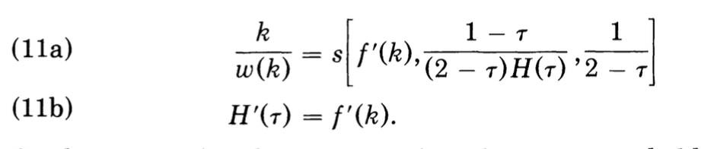
Specific cases
The equations (11a) and (l1b) possess a unique solution, i.e., a balanced growth path supported by labor-augmenting technical progress in the accumulation of human capital.
Notes:
Let us now consider some specific cases. A unique balanced growth path obtains if the utility function is homothetic, the scale factor A is constant, and the rate of labor quality change is independent of current quality,
Equation (lib), on the other hand, traces an upward-sloping
line in (k,r) space when both sorts of capital exhibit diminishing returns, so that at most one solution to (lla)-(llb) exists. A sufficient condition for existence is that both f and H are continuous functions satisfying Inada conditions in their respective arguments.

Slide 11

IV. UNDERDEVELOPMENT TRAPS
Multiple, locally stable balanced growth paths will exist in this model economy whenever individual yields on human capital rise with the average quality of labor.
Notes:
In this section we investigate economies that possess two steady states (one with zero training, another with positive training) when private rates of return on human investment depend positively on the existing average quality of human resources. Externalities in the technology of human capital accumulation will then imply bifurcations that yield quite different development paths out of small differences in initial conditions. In the no-training steady state, the social return to higher average human capital may be high, but the private return to training will be too low to support positive training and therefore a high-income equilibrium.

Slide 12
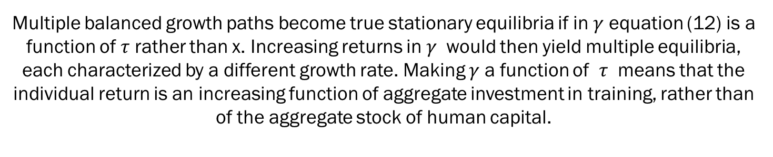
V.MULTIPLE INTERIOR EQUILIBRIA
Multiple balanced growth paths become true stationary equilibria if in $γ$ equation (12) is a function of $τ$ rather than x. Increasing returns in $γ$ would then yield multiple equilibria, each characterized by a different growth rate. Making $γ$ a function of $τ$ means that the individual return is an increasing function of aggregate investment in training, rather than of the aggregate stock of human capital.
Notes:
Actual economic environments are a good deal more complicated than what appears in this section because the private returns to human investment depend on a number of factors that distort individual choices away from what appears in equation (14a). In particular, credit rationing, educational subsidies, and various types of taxes will generally destroy the equality of yield between physical and human capital on which we base our account of growth stages. Nonetheless, we may ask how well actual development data conform to the predictions of a model that abstracts from these complications. The next section looks at this question.

Slide 13
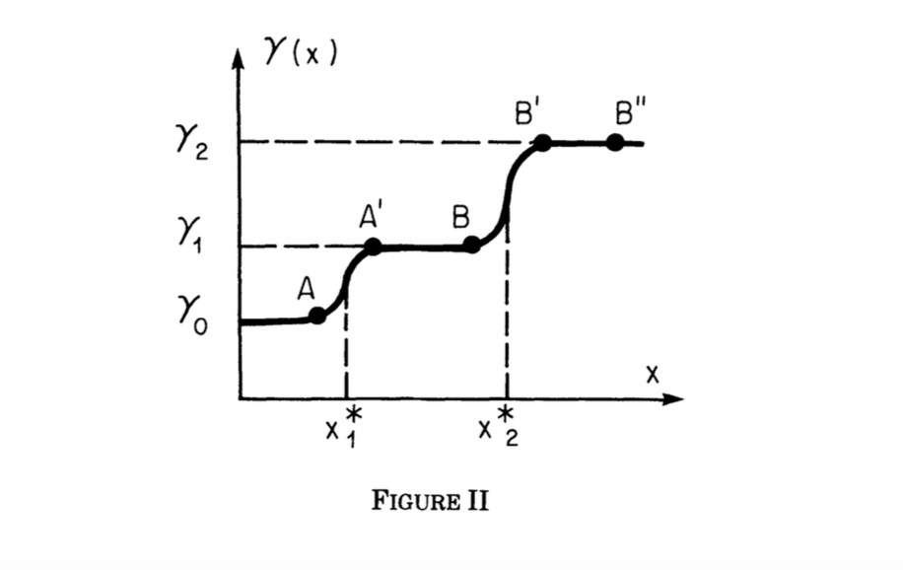
VI. A LOOK AT THE EVIDENCE
What characteristics of the development process would be observed if the threshold externalities associated with human capital accumulation are important in explaining the differences in growth rates set out in Table II?
Economic growth should be correlated with human investment relative to per capita income.
Highly qualified labor force is necessary but not a sufficient precondition for growth.
Notes:
What characteristics of the development process would be observed if the threshold externalities associated with human capital accumulation are important in explaining the differences in growth rates set out in Table I? The simplest answer is that which comes out of a literal interpretation of Figure II and the theoretical apparatus that precedes it. First, consider pairs of economies that are on opposite sides of a given threshold (which implies sharp differences in future growth rates), but still close in terms of income per head (such as A and A' or B and B' in Figure II). Economies to the right of the threshold are investing far more heavily in human capital and accumulating it faster than those to the left of the threshold. Hence, though income would be a poor predictor of future growth rates, sharp differences in the ratio of some human investment measure to income would be correlated with sharp growth differences according to the simple threshold model. Once a particular "stage" has been reached, as in the case of economies such as B' and B", the economies should converge, at least temporarily, to a given balanced growth path.
Of course, for the model to have sharp predictions, one would need to know the location of such human capital thresholds. Do these differ across economies? In the absence of such information, the working hypothesis that emerges is that economic growth should be correlated with human investment relative to per capita income, with high rates of growth being associated with the prior attainment of especially high levels of human investment relative to per capita income. Wasteful economic policies, wars and other political upheavals, natural disasters, and other events may delay progress in an otherwise promising economic environment.

Slide 14
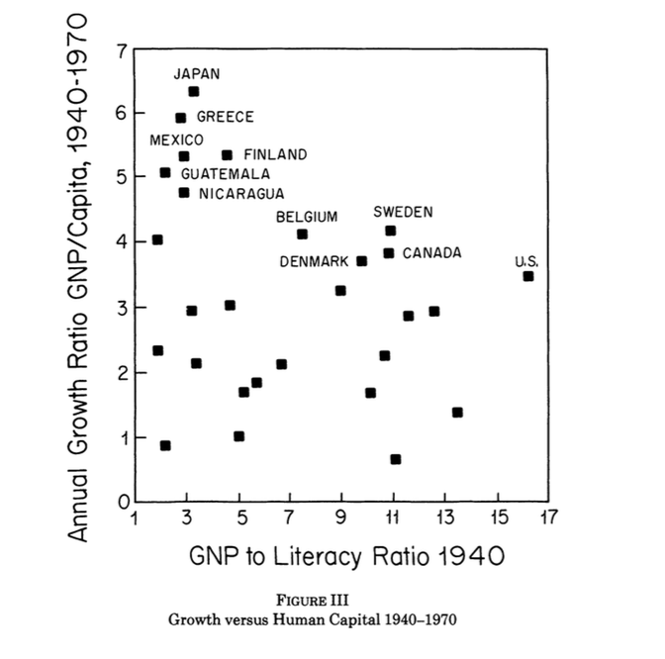
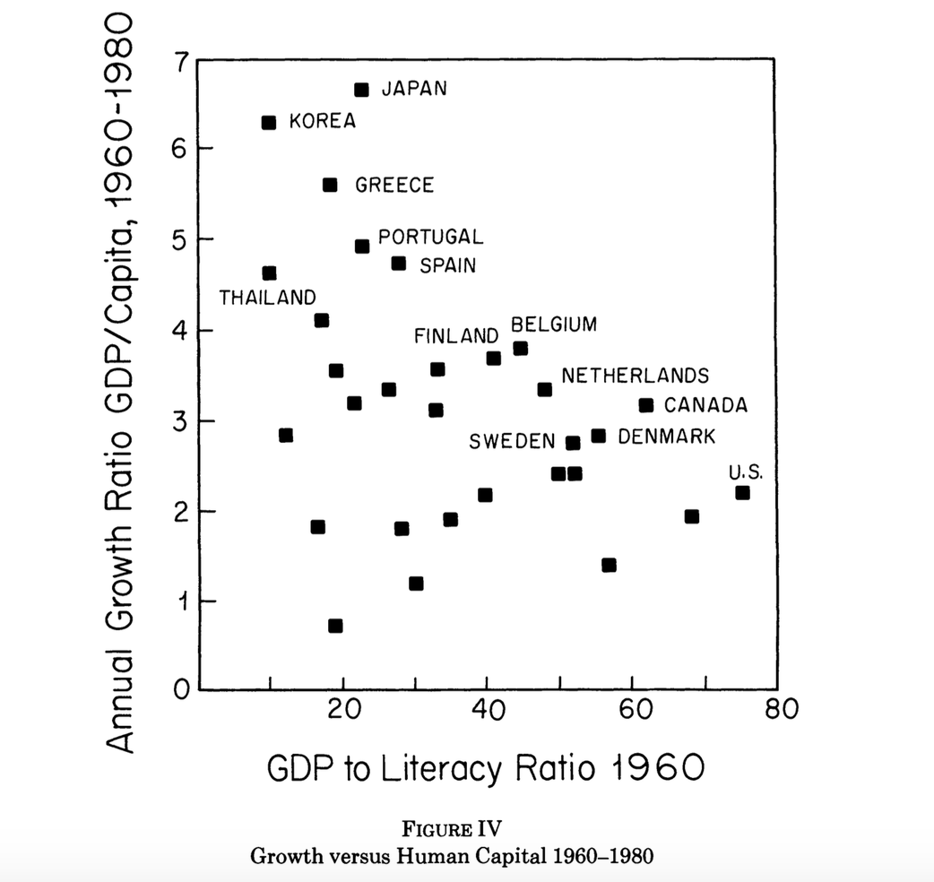
VI. A LOOK AT THE EVIDENCE
Notes:
To see whether this prediction receives any support, we look in Table II at the development experience from 1940 to 1980 of 32 countries for which data are available over the entire sample period. The difficult question of course is how to measure human capital. We use literacy among individuals over ten years old as a proxy for the median amount of human investment, realizing that reliable data on some higher level of educational attainment might be preferable if available.13 We use GNP per capita as our income measure.
Figures III and IV are scatter diagrams of the evidence in Table II. Figure III plots compounded annual growth in per capita GNP from 1940 to 1970 against a measure of relative labor quality in 1940, the (per capita) GNP-to-literacy ratio. Figure IV covers the period 1960-1980, using the Summers-Heston [1988] data set for real GDP, plotting compounded annual growth in per capita GDP against the GDP-to-literacy ratio in 1960.
The key observation is that no data points appear in the upper right-hand side of either plot, which appears to be consistent with the weaker form of the threshold hypothesis outlined above. No country was able to grow quickly during either subinterval without the benefit of a highly qualified labor force. And all those that did grow quickly (Japan, Greece, Mexico, Finland, Guatemala, and Nicaragua in the earlier period; Korea, Japan, Greece, Portugal, Spain, and Thailand in the later period) possessed a labor force that output data, look quite similar.
Each diagram displays a frontier of economic performance. On this frontier,, or close to it, lie countries whose growth rates are the highest givern their literacy-to-per-capita-GNP ratio ,or more their development stage.
highest given their literacy-to-per-capita-GNP ratio or, more generally, their development stage. Examples are Japan, Greece, Finland, Belgium, Denmark, Sweden, Canada, and the United States for both subperiods.
A good distance below the frontier lies a mass of countries that have been expanding much more slowly (and, in some cases, contracting) than the qualifications of their working population would seem to warrant. Many of these countries are in Latin America; some are in Asia; few are in Europe. It is not immediately obvious to us what departures from the idea of section iV are responsible for these slower rates of development. Idealized model imperfections in the working of credit markets, the distortionary effects of government policies, acts of nature, differences in fertility, or some other key feature from which we have abstracted? One part of our agenda for future research is to model how credit market imperfections, endogenous population growth, distinctions of gen- eral versus specific human capital, or subsidies to human invest- ment would affect the working and therefore the empirical predic- tions of the model set out above. However, some preliminary observations about types of countries that lie inside the frontier do suggest themselves.
First, it is not surprising that countries characterized by high fertility (most LDCs) or by outmigration o

Slide 15
VI. A LOOK AT THE EVIDENCE
The most advanced countries do appear to converge. All of these countries have been fully literate since 1940 or earlier, with literacy rates typically in the 95-99 percent range. Among them, the income-to- literacy ratio is a very good proxy for per capita income. As Figures III and IV show, the level and growth rate of income per capita appear to be negatively correlated within this group.
Preliminary OLS regressions using the Summers-Heston data for 1960-1980:
The variation in adult literacy has no explanatory power for variations in growth rates for the high income countries.
The low and middle income countries: the human capital is significant.

